Slide 1

Breast Cancer Detection Using Adaboost Classifier
In this Project, we will dive into the world of breast cancer and the crucial role of early detection. We'll explore the types of breast cancer, the importance of timely diagnosis, and how machine learning is revolutionizing medical diagnostics.

Slide 2
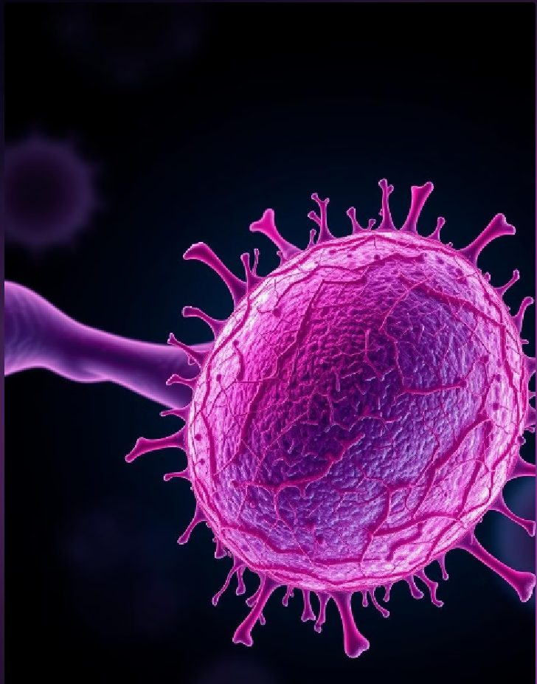
PROBLEM STATEMENT
Breast cancer remains one of the most prevalent cancers worldwide, with early detection being essential for effective treatment and improved survival rates. However, manual diagnosis by traditional methods is time-consuming and lack precision due to human error.
This project aims to leverage machine learning, specifically the AdaBoost classifier, to develop a reliable and accurate model for distinguishing between benign and malignant breast tumors. By analyzing features from widely-used breast cancer dataset, the goal is to enhance diagnostic accuracy and support healthcare professionals in making timely, data-driven decisions for patient care.

Slide 3
Introduction to Breast Cancer
Breast cancer is a common disease marked by the abnormal growth of cells in breast tissue, which can be benign (non-cancerous) or malignant (cancerous). Early detection is critical, as it improves treatment outcomes and survival rates. Advances in screening and diagnostic tools, including machine learning, are enhancing early identification, making timely intervention possible.
Types of Breast Cancer
Malignant Tumors:
Cancerous and aggressive.
Can invade nearby tissues and spread to other parts of the body (metastasis).
Requires immediate treatment for the best outcomes.
Benign Tumors:
Non-cancerous
Do not invade surrounding tissues or spread to other parts of the body.
May still require monitoring or removal if they grow.

Slide 4

Understanding Breast Cancer and the Importance of Early Detection
Breast Cancer Types
Stages of Breast Cancer
Breast cancer can be classified as either ductal carcinoma or lobular carcinoma, based on the origin of the cancer cells.
Breast cancer is staged from 0 to IV, with stage 0 being non-invasive and stage IV being the most advanced.
Importance of Early Detection
Regular Screening
Early detection allows for more effective treatment options and significantly improves the chances of survival.
Mammograms, clinical breast exams, and self-examinations are crucial for the early detection of breast cancer.

Slide 5





Machine Learning in Healthcare for Early Detection
Data-Driven Insights
Automated Diagnosis
Machine learning algorithms can analyze vast amounts of medical data to identify patterns and anomalies that might indicate breast cancer.
ML-powered systems can assist medical professionals in interpreting diagnostic tests, such as mammograms, with greater accuracy and speed.
Predictive Analytics
Remote Monitoring
Machine learning models can help predict the risk of developing breast cancer, enabling proactive screening and early intervention.
Telemedicine and connected devices powered by ML can facilitate remote monitoring and early detection of breast cancer.

Slide 6
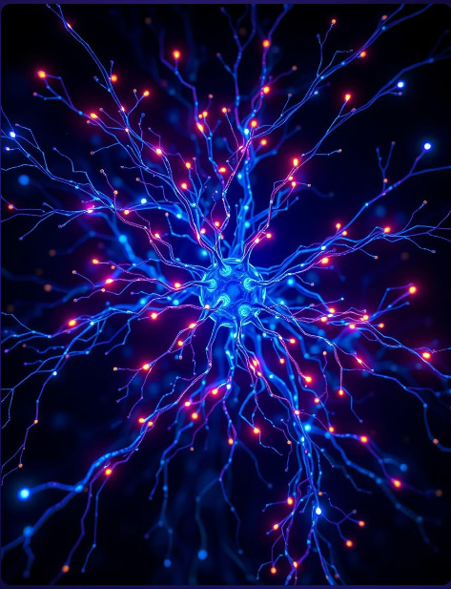
Overview of Adaboost Classifier
Purpose: Combines weak models to create a stronger, accurate classifier.
How It Works: Iteratively adjusts weights to focus on misclassified points, using a series of weak learners.
Benefits: Increases accuracy, especially effective for binary tasks (e.g., benign vs. malignant).
Limitations: Sensitive to noise and outliers.

Slide 7

Data Collection and Preprocessing
The important steps of data collection and preprocessing are essential for building robust machine learning models. We'll use the Wisconsin Breast Cancer Dataset as an example to understand these fundamental techniques.

Slide 8

Understanding the Wisconsin Breast Cancer Dataset
1
Diverse Features
2
Clinically Relevant
3
Balanced Classes
The dataset contains various features such as cell size, shape, and texture that can help predict the presence of breast cancer.
This dataset is widely used in the medical field to develop diagnostic tools and improve cancer detection accuracy.
The dataset has a balanced distribution of benign and malignant samples, making it suitable for training reliable models.

Slide 9
Preprocessing the Wisconsin Breast Cancer Dataset
Handling Missing Values
Balancing With SMOTE
Identify and replace missing values using techniques like mean/median imputation or more advanced methods like KNN imputation.
It helps address class imbalance by generating synthetic samples for the underrepresented class & improving ability to predict both benign and malignant
Outlier Detection
Train-Test Split
Outliers can skew model performance and interpretation, so it is crucial to identify and decide how to handle them during preprocessing
Divide the dataset into training and testing sets to evaluate the model's generalization ability and prevent overfitting.

Slide 10
Inference:
Shape: 569 samples, 31 features – sufficient data for classification.
No Duplicates or Nulls: Dataset is clean, ready for modeling.
Train-Test Split: 70% training (398 samples) and 30% testing (171 samples), ensuring reliable model evaluation.

Slide 11
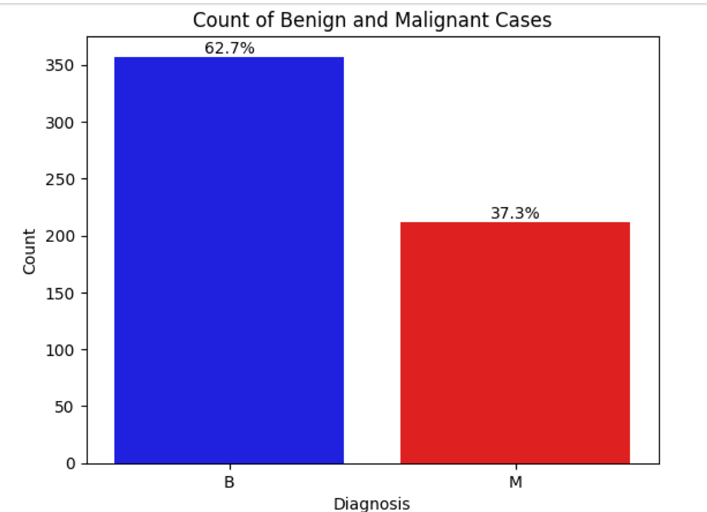
Distribution of Target Variable (Benign vs Malignant)
The countplot helps to understand the imbalance between the two classes (Benign vs Malignant) and provides an immediate visual comparison.
Actionable Insight: This visualization can help in balancing the dataset for modeling if there's a significant class imbalance.

Slide 12
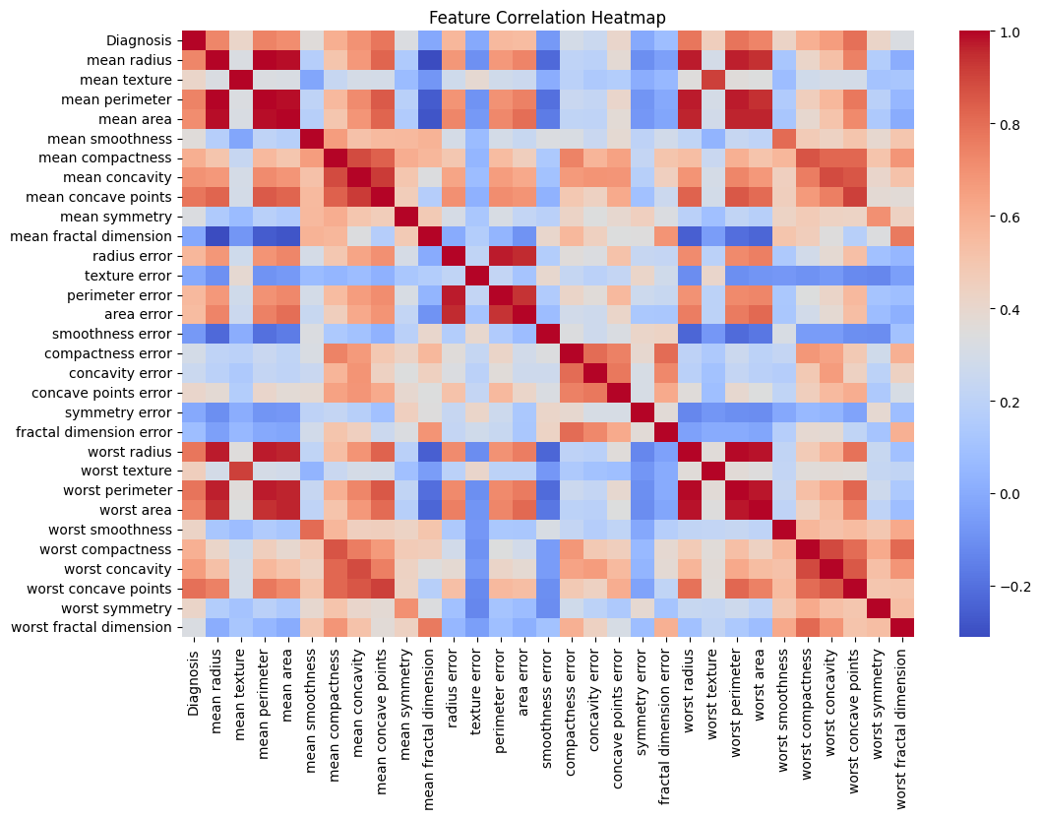
Correlation Heatmap of Features
Correlations helps to identify relationships between features that may be important for building predictive models.
Color Intensity: Darker red values indicate stronger positive correlations, and blue values indicate negative correlations.

Slide 13

AdaBoost and Ensemble Learning Types
AdaBoost (Adaptive Boosting) is a powerful ensemble learning technique that combines multiple weak classifiers to form a strong predictive model. It is a part of the Boosting family of algorithms.
Ensemble techniques are of three types:
Boosting (e.g., AdaBoost): Sequentially trains models, with each correcting the previous one's mistakes to reduce bias.
Bagging (e.g., Random Forest): Trains models in parallel on different data subsets to reduce variance.
Stacking: Combines multiple models' predictions using a meta-model for improved performance.

Slide 14
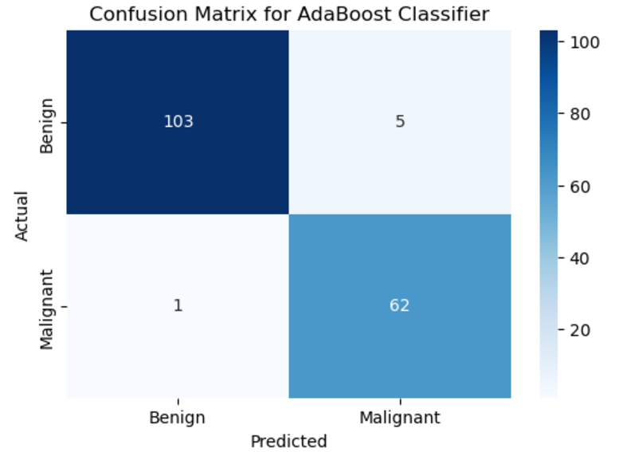
Confusion Matrix
Before Hyperparameter tuning
True Negatives: 103
False Positives: 5
False Negatives: 1
True Positives : 62
Inference: The model demonstrates high accuracy with 62 true positives, 103 true negatives, and minimal errors (5 false positives, 1 false negative).

Slide 15
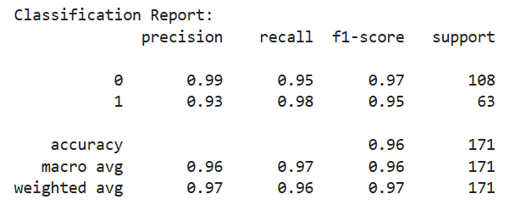
Model Performance Metrics Overview
Classification Report Before Tuning
Precision: 0.9583
Accuracy:0.97076
Recall:0.9682538
F1 Score:0.960629
Inference: The model achieves exceptional performance with 97.1% accuracy, 96% recall, and 96.1% F1 score, indicating high reliability and effectiveness..

Slide 16
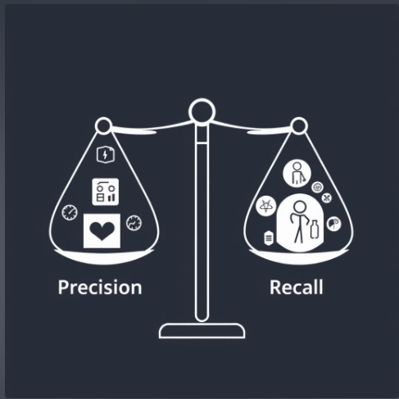
Importance of Precision and Recall in Medical Diagnosis
Precision: Reducing Unnecessary Treatments
Ensures that patients diagnosed with a disease are likely to have it, avoiding unnecessary treatments and procedures.
Recall: Identifying All Affected Patients
Ensures that most patients with the disease are identified, preventing missed diagnoses and enabling timely treatment.
Balance of Precision and Recall
Balancing both metrics is crucial to provide accurate, timely diagnosis and minimize harm from false positives and negatives, leading to better patient outcomes.

Slide 17
Optimizing the Number of Estimators and Learning Rate
Number of Estimators
Learning Rate
Interdependence
The number of weak learners (estimators) in AdaBoost is a crucial hyperparameter. Increasing the number can improve model complexity but may also lead to overfitting.
The learning rate determines how quickly the model updates its parameters during training. Adjusting this parameter can have a significant impact on convergence and final performance.
The number of estimators and learning rate are interdependent - the optimal values for one depend on the other. Careful tuning is required to find the right balance.

Slide 18

Grid Search for Optimal Hyperparameters
1
Define Search Space
Identify the relevant hyperparameters and define a range of possible values to explore.
2
Construct Grid
Create a grid of all possible combinations of the hyperparameter values.
3
Evaluate Grid
Train the AdaBoost model for each combination of hyperparameters and evaluate the performance.
The optimal hyperparameters will be the combination that yields the best performance on the evaluation metric, such as accuracy or F1-score.

Slide 19
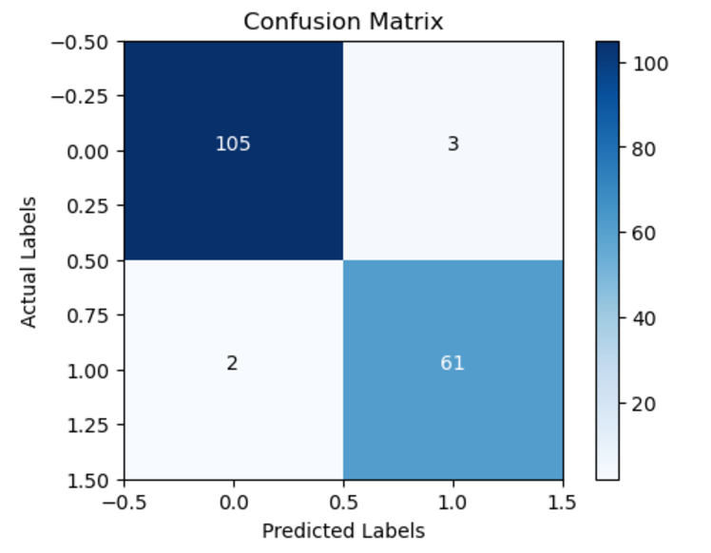
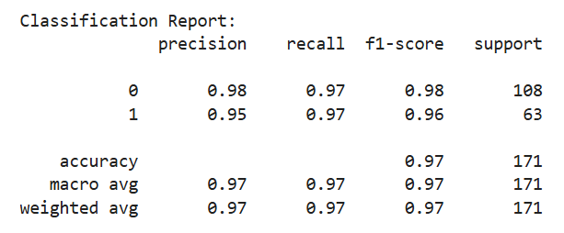
Confusion Matrix and Classification Report After
Hyperparameter Tuning
Inference:Achieved 97% accuracy with balanced precision, recall, and F1-score, demonstrating minimal misclassifications and high model reliability.

Slide 20
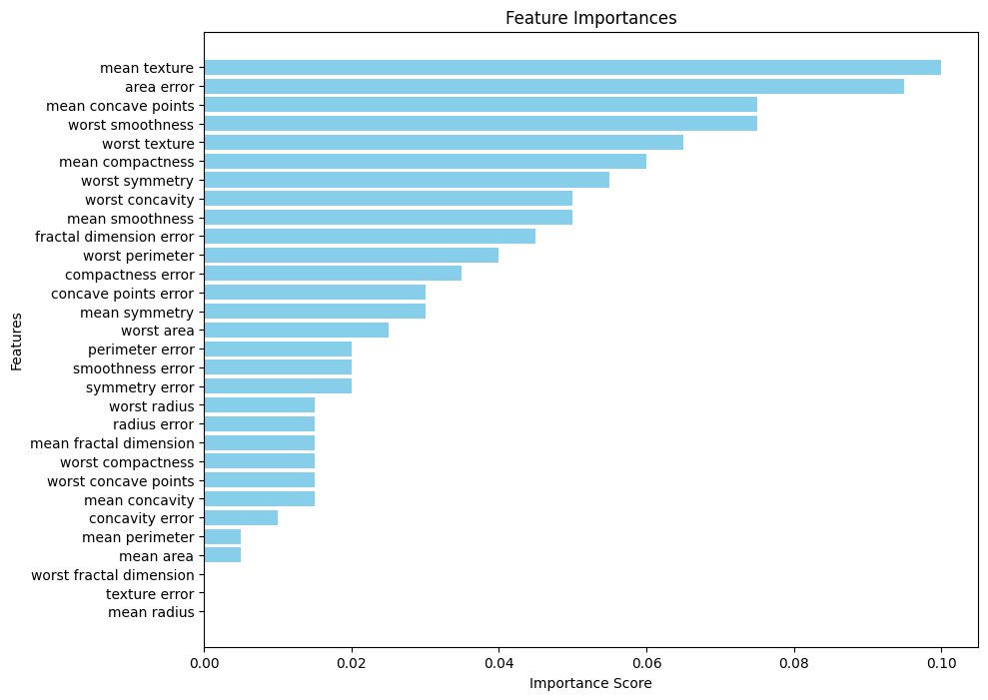
Extracting and Visualizing Important Features
Identifying and understanding the most salient features within a dataset is a crucial first step in effective data analysis.
This presentation will explore techniques for extracting and visualizing the key drivers and patterns that lie at the heart of your data.

Slide 21
Understanding ROC Curves and AUC
ROC Curves
AUC
Interpretation
The Receiver Operating Characteristic (ROC) curve is a graphical tool that illustrates the diagnostic ability of a binary classifier system as its discrimination threshold is varied.
The Area Under the Curve (AUC) is a summary statistic that represents the overall accuracy of the model. A higher AUC indicates better predictive performance.
ROC curves and AUC provide valuable insights into model performance, helping you assess trade-offs between true positive and false positive rates.

Slide 22
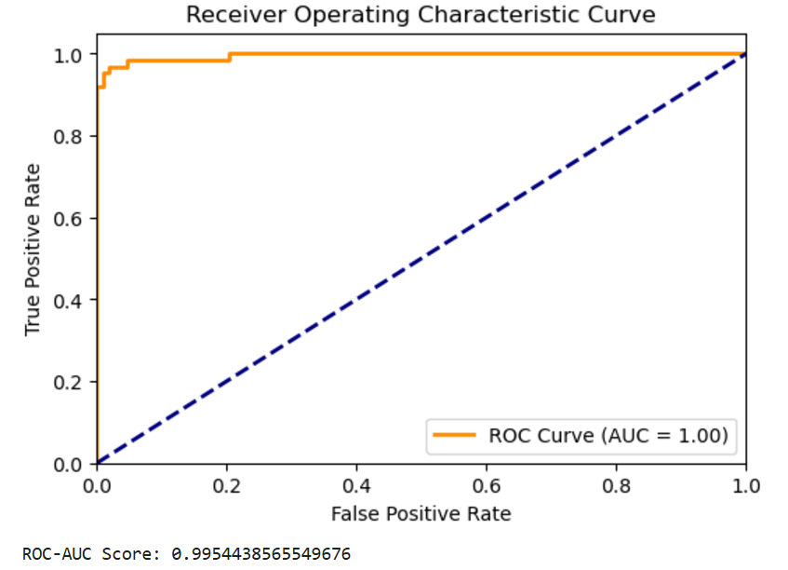
ROC Curve:
The Receiver Operating Characteristic (ROC) curve illustrates the tradeoff between the true positive rate (sensitivity) and false positive rate for the model across various thresholds.
Key Highlight: The Area Under the Curve (AUC) is nearly 1.00, indicating that the model demonstrates excellent discriminatory power and is highly effective in distinguishing between the classes.

Slide 23

Serializing the trained machine learning model using Joblib
1
Train the Model
Use scikit-learn to train a robust machine learning model on a comprehensive medical dataset.
2
Serialize with Joblib
Save the trained model to disk using the Joblib library for easy retrieval and reuse.
3
Load and Deploy
Load the serialized model into the Streamlit application for real-time disease prediction.

Slide 24
Deploying the model using Streamlit
Streamlit Framework
Intuitive UI
Rapid Deployment
Streamlit provides a user-friendly, no-code way to build and deploy data-driven web applications.
The application features an intuitive, easy-to-use interface for medical professionals to input patient data.
Streamlit's simple deployment process allows the model to be quickly accessible to end-users.

Slide 25
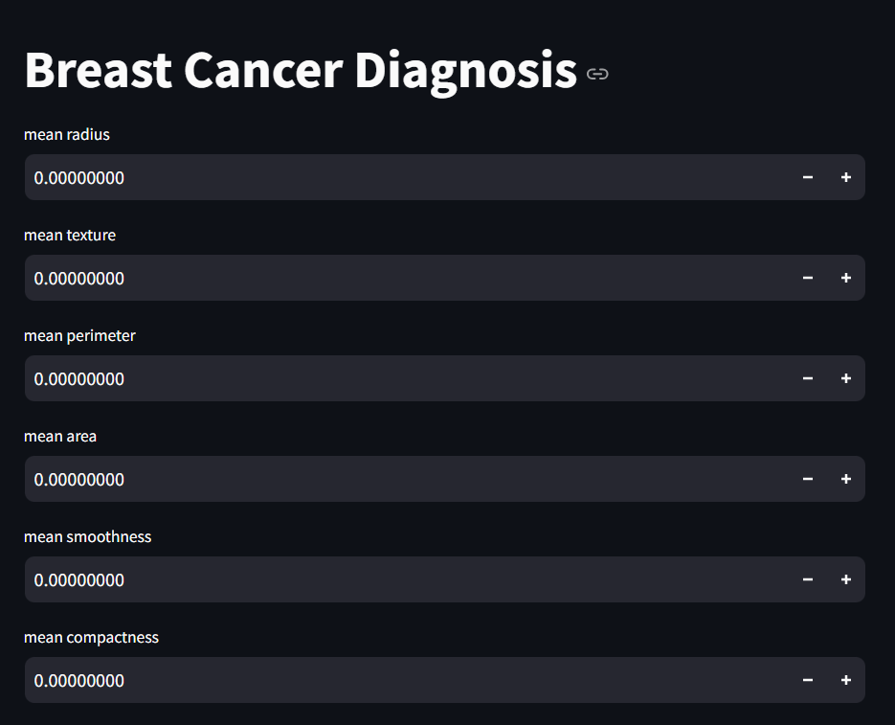

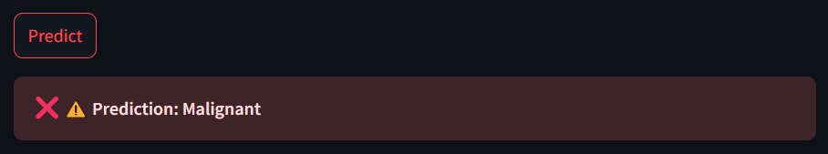
User Interface(UI) of Deployed Web Page
Predictions Display:
The web interface allows users to input diagnostic data and receive real-time predictions for Benign (green) or Malignant (red) results.

Slide 26
THANK YOU
-Team 3

